Slide 1
Data Warehouse of Loans in Financial Institute: BankOne
Abhigyan Borah (2020H1120288P)
Divyanshu Varma (2020H1120284P)
Avinash Narendra (2020H1120302P)
Nedunuri Sai Charan (2020H1120281P)

Slide 2
Introduction
Financial Institutions like Central Banks, Commercial Banks, Loan Associations handle a wide variety of user and transactional data.
User Data includes the Customer details, Account details of customers whereas Transactional data includes various operations on Bank accounts from savings to the issue and repayment of loans.
Utilisation of this data to its full potential is required to decide upon taking management decisions to forecast business trends and to identify financial defaulters.

Slide 3
Introduction Contd.
The goal is to create data warehouse for Financial Institutions which allows the access to updated, aggregated information, regarding bank accounts.
Bringing decentralised, inconsistent operational data to be utilised to its full potential.
End results enable financial administration staff of the institution to access to a comprehensive view of the organization, supporting forecasting and decision-making processes at the enterprise level.
Development of a Business Intelligence (BI) project, implemented by the construction of a data warehouse (DW) and its Online Analytical Processing (OLAP) cube, for managing financial institution.

Slide 4
Overview
Things to measure:
Loan Payments and Re-Payments
Account Balance
Credit Score
Assumptions:
Grain is every single repayment of loan.
Incremental loading happens daily.
One account per customer.
A joint account can be opened for up to two customers.
Notes:
Date because loans are a lengthy affair and it does not make sense to track them by their hourly or on minute basis.

Slide 5
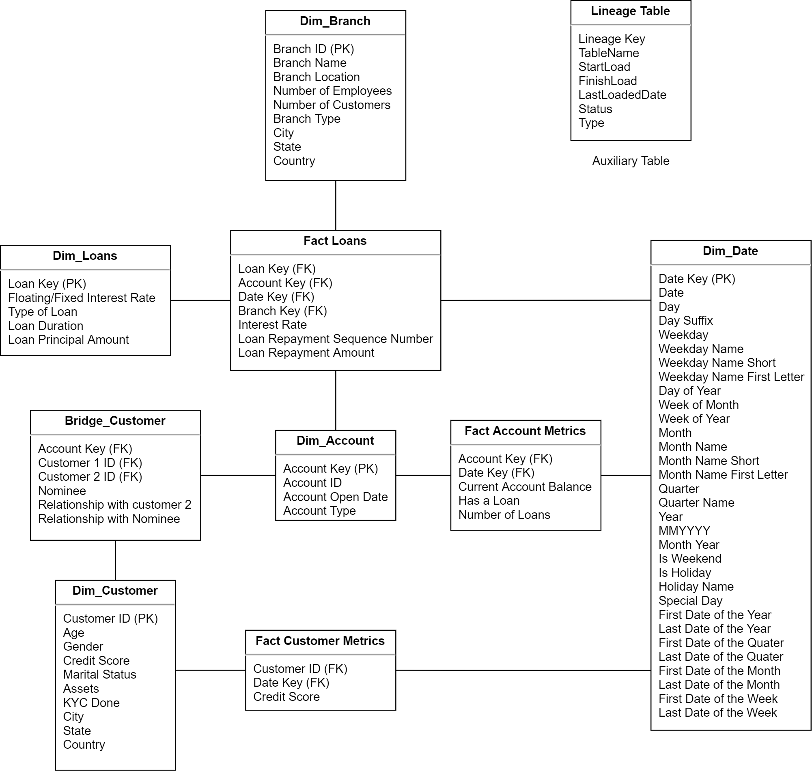
Schema Design
Notes:
Customer dimension
‘KYC Missing’ is written in full because this is a data warehouse where the business users will see the field as option in their interface like PowerBI and having an option as True there makes no sense to the business user.
We did not create a location dimension intentionally because we wanted to first of denormalize. Moreover both branch and Customer will have this location which will impair our ability to join them in any report.
Age is computed in the ETL process and the increment is done using a daily cron script for those with their birthday. We do this because it will ease the life of Business users as age is a common .

Slide 6
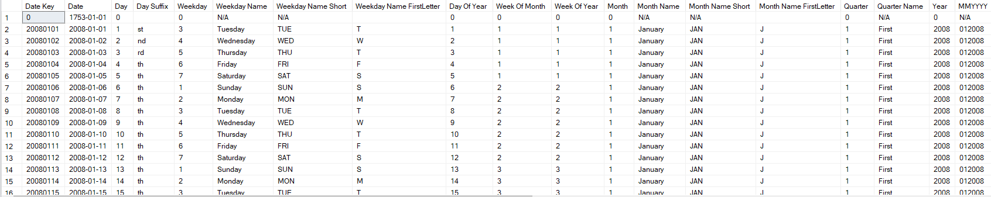
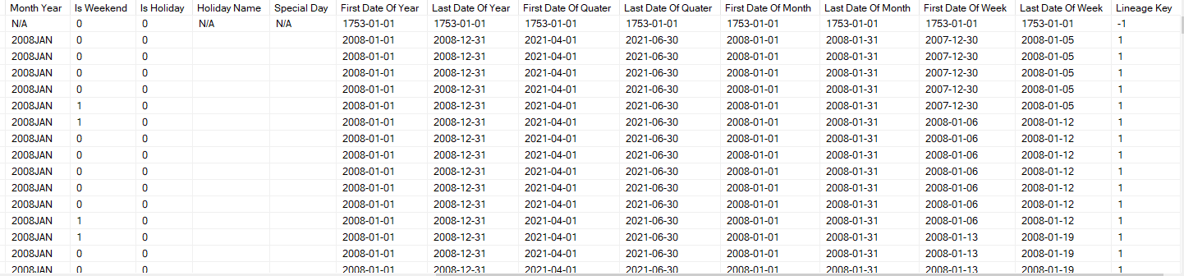
Why is our DATE Dimension so wide?
Notes:
Business users may need the date formatted in a variety of way in their BI tool and this

Slide 7
Why is there a Bridge Table?

Slide 8
Contribution to Project
Avinash Narendra
Schema design
Choice of Grain
Data Lineage and Incremental load list
Transformation of Data for Loading and schema
Presentation
Overall review
Abhigyan Borah
Schema design
Determining Business Objectives
Generation of dummy data
Schema diagram
Notes:
Avinash: Grain of Fact_Loans is each loan repayment
Abhigyan:

Slide 9
Contribution to Project
Divyanshu Varma
Schema design
Presentation
First draft (star schema)
Literature survey
Bridge Table
Nedunuri Sai Charan
Schema design
Generation of dummy data
Presentation

Slide 10
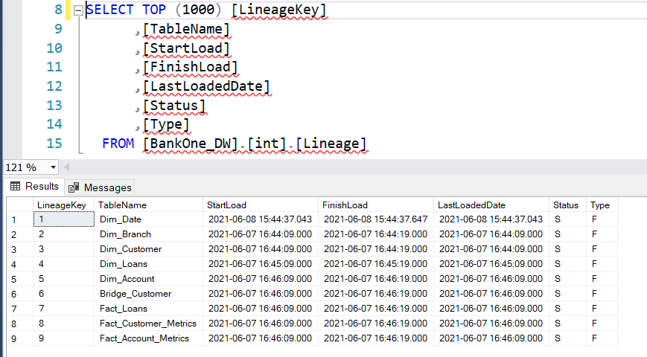
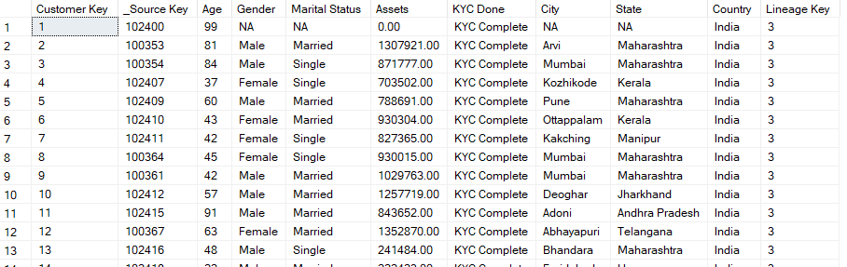
Data Lineage

Slide 11
Data Lineage and Incremental Load
Way to keep track of Error in Loading
Gives the business person more trust in the data
09.05.XX
09.17.XX
10.13.XX
10.20.XX
11.01.XX
Transparent Business Rules
Business person knows exactly how well updated the data is

Slide 12
Sample Query
SELECT [City], [State], [Loan Duration], [Loan Principal Amount],
SUM([Loan Repayment Amount]) AS Loan_Repayment_Amount
FROM [Fact_Loans] fl INNER JOIN [Dim_Branch] db
ON fl.[Branch Key] = db.[Branch Key] INNER JOIN [Dim_Loans] dl
ON fl.[Loan Key] = dl.[Loan Key]
GROUP BY [City], [State], [Loan Duration], [Loan Principal Amount]
ORDER BY [City], [State], [Loan Duration], [Loan Principal Amount]

Slide 13
Show marital status
SELECT [Marital Status], [Age], [Current Account Balance]
FROM [Fact_Account_Metrics] fam INNER JOIN [Dim_Account] da
ON fam.[Account Key] = da.[Account Key] INNER JOIN [Bridge_Customer] bc
ON da.[Account Key] = bc.[Account Key] INNER JOIN [Dim_Customer] dc
ON bc.[Customer 1 Key] = dc.[Customer Key]
WHERE fam.[Date Key] = 20170601
ORDER BY [Marital Status], [Age], [Current Account Balance]

Slide 14
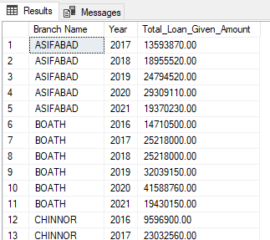
Show total amount of loan given per year per branch
SELECT [Branch Name], [Year],
SUM([Loan Principal Amount]) AS Total_Loan_Given_Amount
FROM [Fact_Loans] fl INNER JOIN [Dim_Date] dd
ON fl.[Date Key] = dd.[Date Key] INNER JOIN [Dim_Loans] dl
ON fl.[Loan Key] = dl.[Loan Key] INNER JOIN [Dim_Branch] db
ON fl.[Branch Key] = db.[Branch Key]
GROUP BY [Branch Name], [Year]
ORDER BY [Branch Name], [Year]

Slide 15
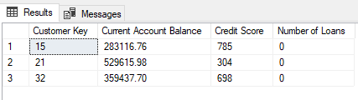
Show the bank balance and credit score of a customer at a given date
SELECT fcm.[Customer Key], [Current Account Balance], [Credit Score], [Number of Loans]
FROM [Fact_Customer_Metrics] fcm INNER JOIN [Dim_Customer] dc
ON fcm.[Customer Key] = dc.[Customer Key] INNER JOIN [Bridge_Customer] bc
ON dc.[Customer Key] = bc.[Customer 1 Key] INNER JOIN [Fact_Account_Metrics] fam
ON bc.[Account Key] = fam.[Account Key]
WHERE fam.[Date Key] = 20120201
AND fcm.[Date Key] = 20120201
ORDER BY [Customer Key], [Current Account Balance], [Credit Score], [Number of Loans]

Slide 16
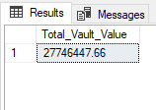
Bank’s Market Valuation (Today) [Total of all debt with the bank]
SELECT SUM([Current Account Balance]) AS Total_Vault_Value
FROM [Fact_Account_Metrics] fam
WHERE fam.[Date Key] = 20180101

Slide 17
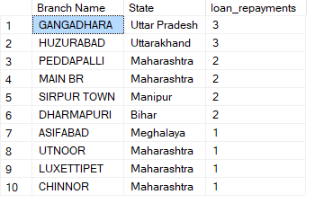
Which Branch had the most loan repayments on a given month ?
select TOP (10) [Branch Name],[State], count(*) as loan_repayments from [Fact_Loans]
inner join [Dim_Branch] ON [Fact_Loans].[Branch Key] = [Dim_Branch].[Branch Key]
inner join [Dim_Date] ON [Fact_Loans].[Date Key] = [Dim_Date].[Date Key]
where [Dim_Date].[MMYYYY] = '012018'
group by [Branch Name],[State]
order by count(*) desc

Slide 18
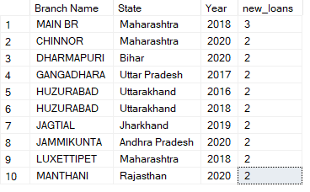
Which is the best branch based on the number of new loans issued?
select top(10) [Branch Name],[State],[Year], count(*) as new_loans from [Fact_Loans]
inner join [Dim_Branch] ON [Fact_Loans].[Branch Key] = [Dim_Branch].[Branch Key]
inner join [Dim_Date] ON [Fact_Loans].[Date Key] = [Dim_Date].[Date Key]
where [Loan Repayment Sequence Number] = 0
group by [Branch Name],[State], [Year]
order by count(*) desc
Notes:
Avinash Explains loan_repayment = 0 logic.
Educational Loan

Slide 19
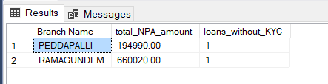
Anomaly detection
select [Branch Name],sum([Loan Principal Amount]) as total_NPA_amount,count(*) as loans_without_KYC from [Fact_Loans]
inner join [Bridge_Customer] on [Bridge_Customer].[Account Key] = [Fact_Loans].[Account Key]
inner join [Dim_Customer] on [Dim_Customer].[Customer Key] = [Bridge_Customer].[Customer 1 Key]
inner join [Dim_Branch] on [Dim_Branch].[Branch Key] = [Fact_Loans].[Branch Key]
inner join [Dim_Loans] on [Dim_Loans].[Loan Key] = [Fact_Loans].[Loan Key]
where [Loan Repayment Sequence Number] = 0
and [KYC Done] = 'KYC Missing'
group by [Branch Name]

Slide 20
https://github.com/vintas/Loan-Data-Warehouse
Open Access to replicate our warehouse with clear instructions

Slide 21
Thank You

